Slide 1

Pixart Analyse
Die Entfernung welcher Transformer Blocks hat den größten Einfluss auf das finale Bilde

Slide 2
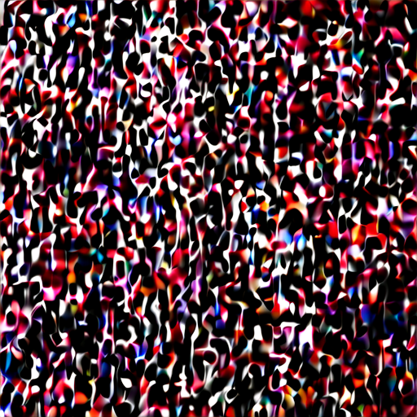


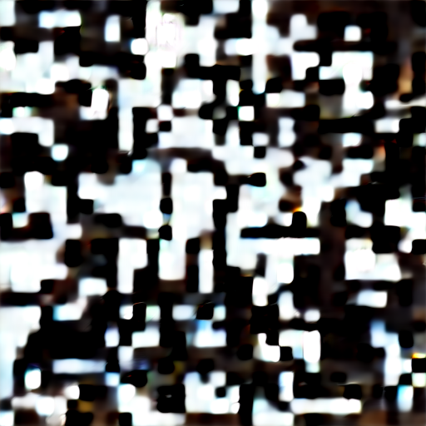





















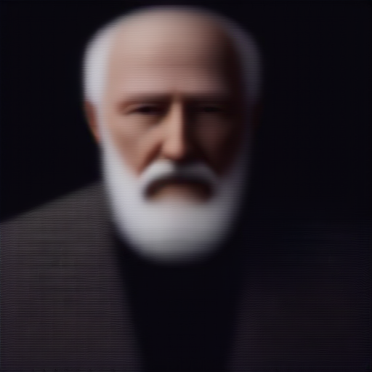

Original
Block 1
Block 2
Block 3
Block 4
Block 5
Block 6
Block 7
Block 8
Block 9
Block 10
Block 11
Block 12
Block 13
Block 14
Block 15
Block 16
Block 17
Block 18
Block 19
Block 20
Block 21
Block 22
Block 23
Block 24
Block 25
Block 26
Block 27
Block 28
Notes:
4,7,16,19, 22

Slide 3



























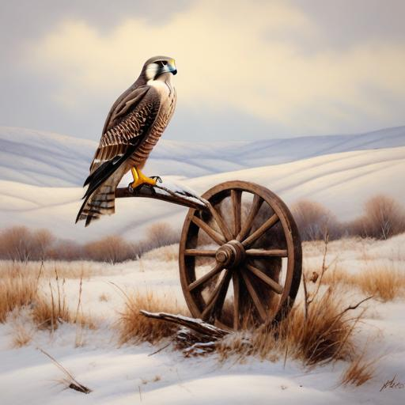
Original
Block 1
Block 2
Block 3
Block 4
Block 5
Block 6
Block 7
Block 8
Block 9
Block 10
Block 11
Block 12
Block 13
Block 14
Block 15
Block 16
Block 17
Block 18
Block 19
Block 20
Block 21
Block 22
Block 23
Block 24
Block 25
Block 26
Block 27
Block 28
Notes:
4,7,16,19, 22

